Slide 1

Introduction to SCALA
Dorothy Kucar

Slide 2
Agenda
Introduction
Types
Expressions, if-else, while
Functions (first class, higher order, anonymous functions)
Strings
Tuples
Arrays
Lists

Slide 3
Scala
Created by Martin Odersky and team in 2001
Integrated with principles from
Functional programming
Object-oriented programming
Scalable language
Allows a gradual, easy migration to a more functional style
Seamless Java interoperability
Compiles into bytecode and runs on the JVM
Java libraries and frameworks can also be used

Slide 4
Scala for Spark and Data Science
Spark was written in Scala, therefore
Access to latest n greatest Spark features!!
New features come out in Scala before Python/R/Java
Some features aren’t even written in Python/R/Java i.e. GraphX
Scala has built in support for distributed/parallel computing, so it will be the language you use when building production-quality data science code
In contrast, writing distributed computing code in Python is complex https://www.toptal.com/python/beginners-guide-to-concurrency-and-parallelism-in-python

Slide 5
Salient Features
Statically typed language
It can infer types from incoming data
Object-oriented
Every value is an object
Every operation is a function call
Functional
Functions are also objects!
Functions can call other functions
Multiple forms of execution
Traditional compilation (i.e. using command line or Eclipse IDE)
Scala REPL (i.e. through command line or Databricks Community Edition notebook)

Slide 6
Frameworks built using Scala
Distributed data processing engine
Extensible RPC system for the JVM
Publish-subscribe messaging system
Fast and extreme concurrent framework
Web application framework

Slide 7
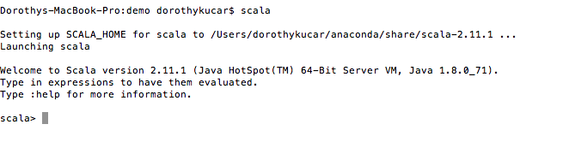
Scala via Command Line
To set up a local copy of command line Scala
https://www.tutorialspoint.com/scala/scala_environment_setup.htm

Slide 8
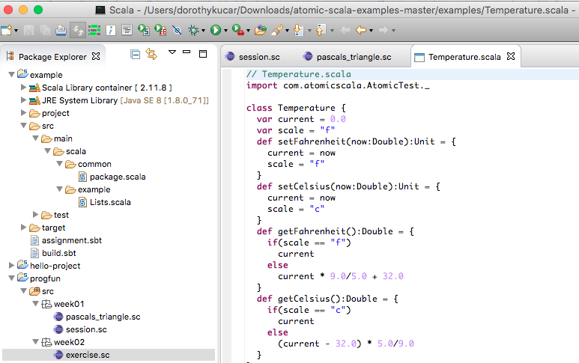
Scala via Eclipse IDE
We will use Eclipse later on in this course to develop more involved Scala code, but for now, just a screenshot

Slide 9
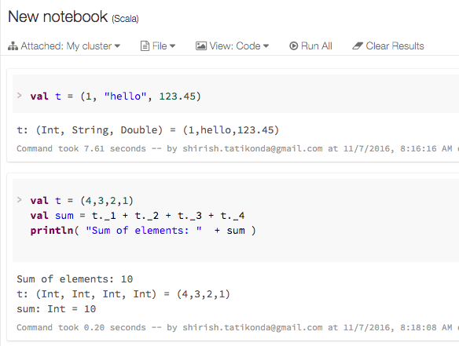
Scala Via Databricks
For the examples in today’s class, we’ll use Databricks REPL

Slide 10
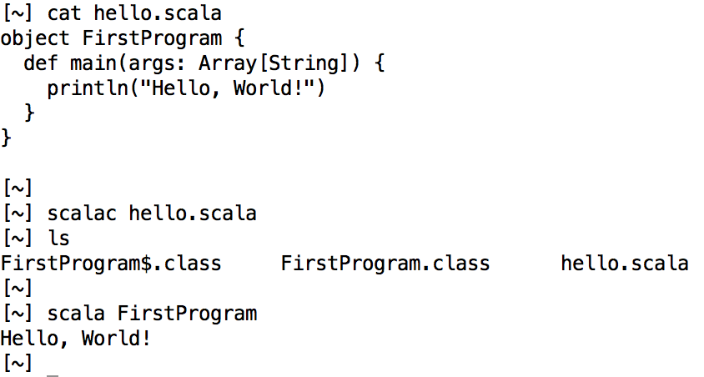
A Little Bit on Java Byte Code
Scala Compiler
First Program class compiled to Java Byte Code

Slide 11
.class files + Java bytecode
.class file = binary file containing Java bytecode that can be executed on a Java Virtual Machine
Bytecode = Instruction set of the Java virtual machine.
Each bytecode is composed of one or two bytes that represent the instruction (opcode)
along with zero or more bytes for passing parameters.

Slide 12
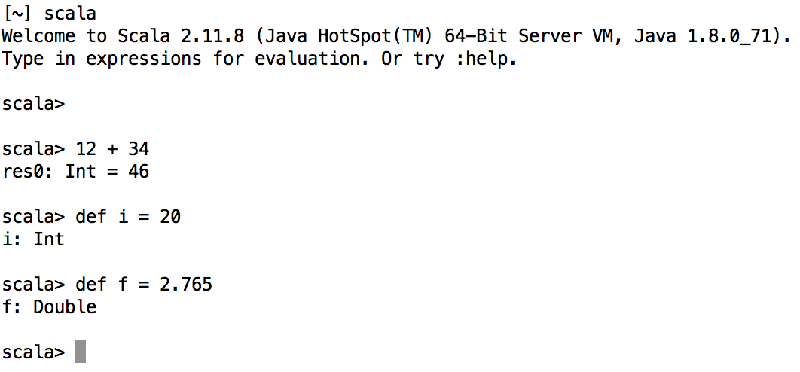
Scala REPL
Read-Evaluate-Print-Loop
Provides an interpreter feel

Slide 13
Type System
Unified type system
Everything is an object
There are no primitive types, unlike in Java

Slide 14
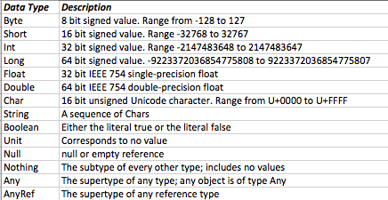
Data Types

Slide 15
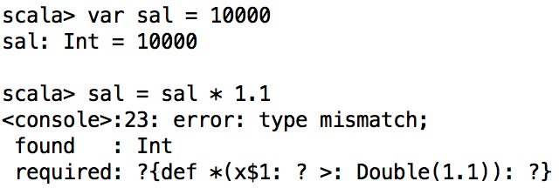
Type Inference
Foundational in functional languages
Automatic deduction of data type of expressions
Scala is statically typed
Type inference is done at compile time
Type mismatches are errors!
Once a type is assigned, it remains the same for the entire scope

Slide 16
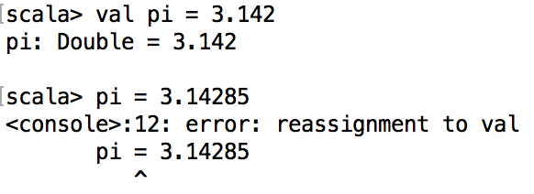
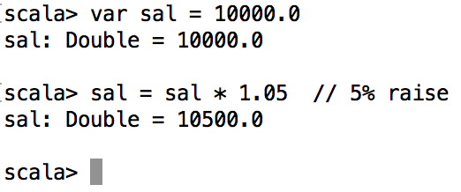
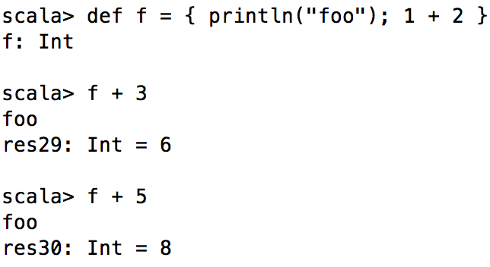
Expressions
Expressions evaluate to a value (with associated type)
Almost everything is an expression in Scala
Define values and variables using expressions
val – Immutable by-value definition
var – Mutable definition
def – By-name definition

Slide 17
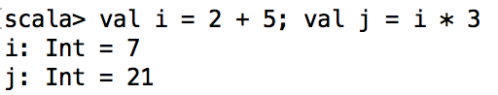
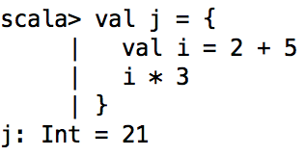
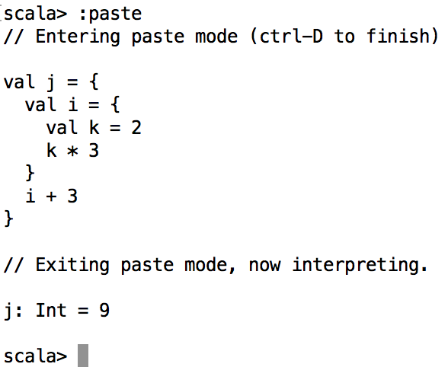
Block expression
Multiple expressions combined using curly braces
Last expression is the return value for the entire block
They can be nested as well

Slide 18
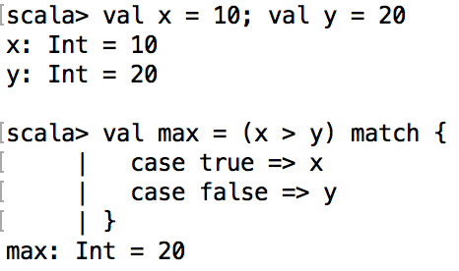
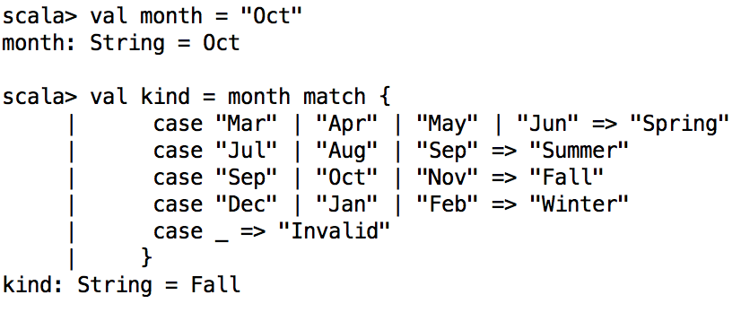
match expression
<expression> match {
case <identifier | pattern match> => <expression>
[case...]
}
Similar to “switch”
only 0 or 1 patterns can match
Enables matching
types, regular expressions, numeric ranges, and data structure contents as well
Alternative patterns
“default or catch-all” pattern
Notes:
matches a value against patterns of different types:
object MatchTest2 extends App {
def matchTest(x: Any): Any = x match {
case 1 => "one"
case "two" => 2
case y: Int => "scala.Int"
}
println(matchTest("two"))
}

Slide 19

Exercise
Write a match expression that evaluates a web status code, where
200 means “OK”,
404 means “Not Found”,
500 means “Internal Server Error”
502 means “Bad Gateway”
Anything else is “Error”
val status = 500
val message = < you fill in > match {
| case 200 => < you fill in >
}
}

Slide 20
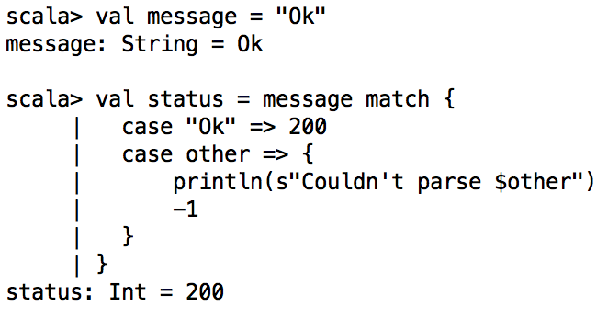
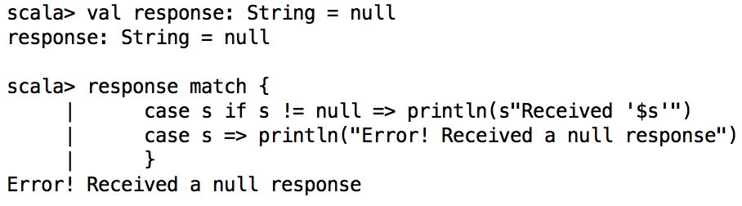
match expreson – 2
Value binding match
Pattern guards
case <identifier> => <expression>
case <pattern> if <boolean expression> => <expression>

Slide 21
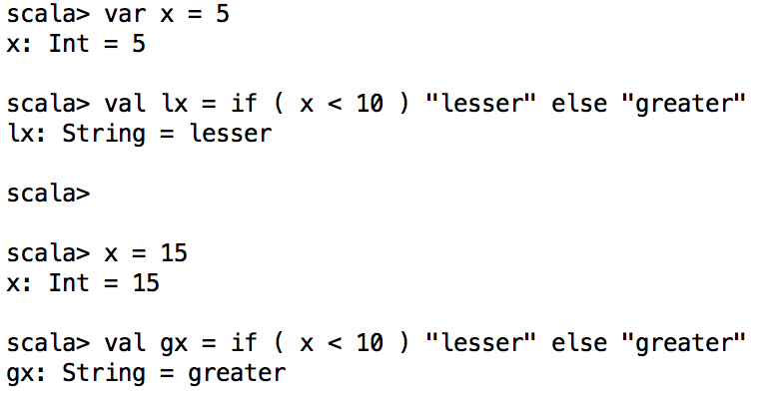
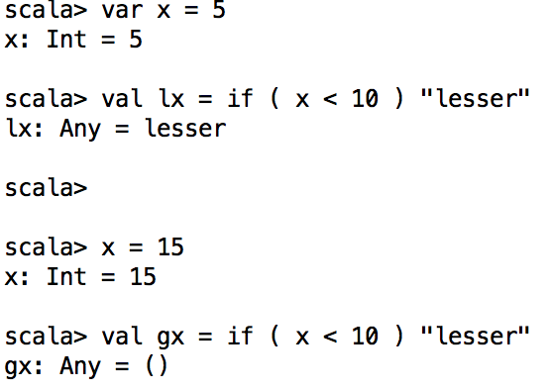
if-else expression
if ( <boolean expression> )
<expression>
if ( <boolean expression> )
<expression>
else
<expression>
Return value depends on the condition
Return type is determined from both the branches

Slide 22
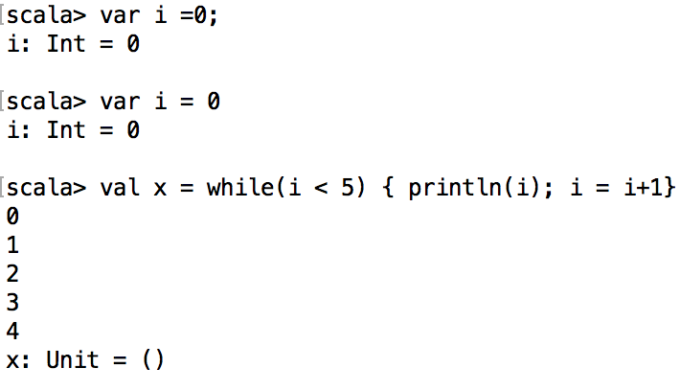
While loop
Return type is always Unit
type Unit has only one return value: ()
Note of caution!
var line = "”
while ((line = readLine()) != "") // This does not work!
println("Read: "+ line)
Notes:
Assignment to var returns unit value ()
scala> var z = 10
z: Int = 10
scala> val x = (z = 20)
x: Unit = ()

Slide 23
for-loop or for-comprehention
List comprehensions are a tool for transforming one list (any iterable collection actually) into another list
Numeric Range:
<starting integer> [to|until] <ending integer> [by increment]
Series of values to iterate on
(can be conditioned!)
Loop variable
for (<identifier> <- <iterator>) [yield] [<expression>]
Expression to evaluate
for each iteration
If specified, return values from
each expression are returned as a collection

Slide 24
for-comprehensions
Normal loop
w/ yield
Nested loops
Iterator guards
Variable binding
What is the return type of println? Of yield?
for (x <- 1 to 7) println( s"Day $x:" )
for (x <- 1 to 7) yield { s"Day $x:" }
for (x <- 1 to 5; y <- 1 to 3)
println( s”($x, $y)” )
val threes =
for (x <- 1 to 30 if x % 3 == 0) yield x
val powersOf2 =
for (i <- 0 to 8; pow = 1 << i) yield pow
Notes:
scala> val quote = "Faith,Hope,,Charity"
quote: String = Faith,Hope,,Charity
scala> for {t <- quote.split(",")
if t != null
if t.size > 0} { println(t) }

Slide 25
Goal: Write this kind of code
object WordCount {
def main(args: Array[String]) {
val master = args.length match {
case x: Int if x > 0 => args(0)
case _ => "local"
}
val sc = new SparkContext(master, "WordCount", System.getenv("SPARK_HOME"))
val input = args.length match {
case x: Int if x > 1 => sc.textFile(args(1))
case _ => sc.parallelize(List("pandas", "i like pandas"))
}
val words = input.flatMap(line => line.split(" "))
args.length match {
case x: Int if x > 2 => {
val counts = words.map(word => (word, 1)).reduceByKey { case (x, y) => x + y }
counts.saveAsTextFile(args(2))
}
case _ => {
val wc = words.countByValue()
println(wc.mkString(","))
}
}
}
}

Slide 26
FUNCTIONS AND CLOSURES
Many uses of the _ character and other gems

Slide 27
First Class Functions
Types for parameters is mandatory
Return type can be inferred, except for recursive functions
The return keyword is optional (but not really recommended)
def sq( x: Int ) = { x * x }
def cube( x: Int) = Math.pow(x,3)
def area( r: Int ) = 3.14 * sq(r)
Function signature: name, inputs, outputs
Function type: inputs, outputs
Type of sq function: Int => Int i.e., takes a Int as an argument and returns an Int
Type of area function: Int => Double

Slide 28
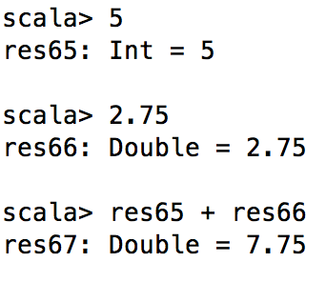
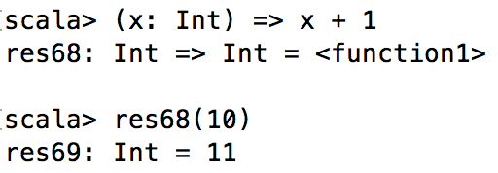
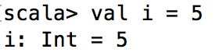
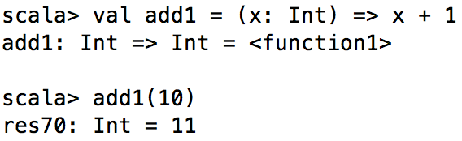
Anonymous functions
Also known as lambda or function literals
Functions can be defined just like common literals/constants
Most useful when passing functions as arguments
They can also be assigned names
([<identifier>: <type>, ... ]) => <expression>

Slide 29
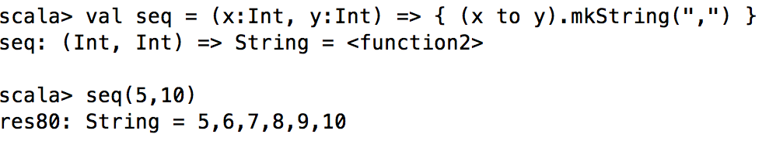
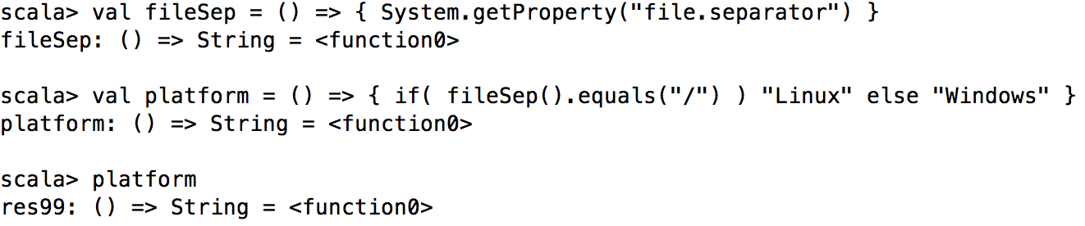
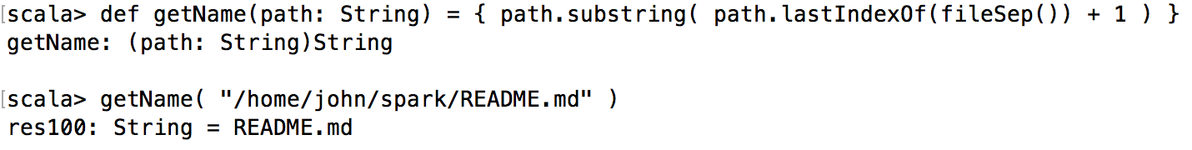
Anonymous Functions
They can be defined with multiple parameters
They can be defined with no parameters as well

Slide 30
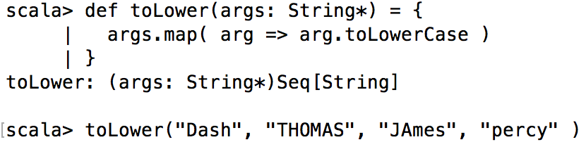
Higher-order functions
Functions taking functions as arguments
Functions returning a function as results
Higher order function
Variable number of arguments
Anonymous function of type String => String

Slide 31
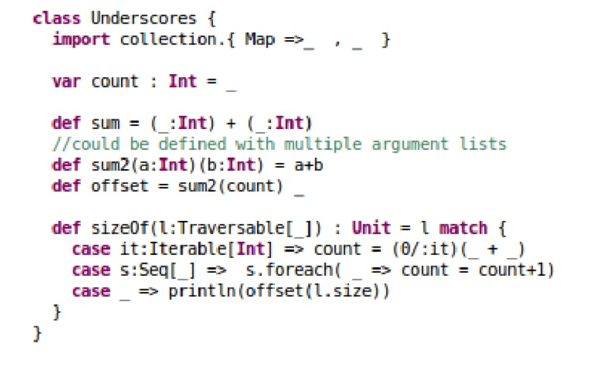
Underscores I

Slide 32
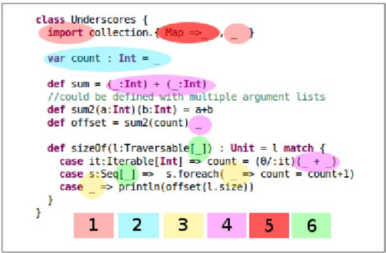
Underscores II
Import everything
Initialize var to default value
Unused variables
Anonymous parameters
Don’t import name in namespace
Existential type

Slide 33
Placeholder Syntax I
Shortened form of function literals, replacing named parameters with wildcard operators (_)
Example list:
val someNumbers = List(-20,-15,-5,0,5,10)
List numbers greater than 0
someNumbers.filter(x => x>0)
Same thing, now using wildcard operator, _
someNumbers.filter(_ > 0)

Slide 34
Placeholder Syntax II
If you use multiple underscores, then that implies multiple parameters, NOT reuse of single parameter repeatedly
1st _ represents 1st parameter, 2nd _ represents 2nd parameter
Example below yields missing parameter type
val x = _ + _
Instead use
val x = (_: Int) + (_: Int)

Slide 35
Partial Application of Functions
Replace entire parameter list with underscore
We get another function as a result
Make sure to leave a space between function name and underscore otherwise compile thinks you’re referring to a different symbol i.e. println _ vs println_
Example: instead of
someNumbers.foreach(x => println(x))
Use
someNumbers.foreach(println _)
Notes:
val foo = (x:Int, y:Double, z: String) => { x + " " + y + " " + z }
val f = foo(2, _: Double, "Hello")
f(3.5)
>>> 2 3.5 Hello

Slide 36
Partial Application of Functions II
Given
def sum(a: Int, b: Int, c: Int) = a+b+c
Create a partially applied function by supplying NONE of the required arguments
Note a is still a function! (not an Int)
val a = sum _
a: (Int, Int, Int) => Int = <function3>
So If we try, should work as expected
a(4,5,6)

Slide 37
Partial Application of Functions III
You can also retain SOME of the parameters
val b = sum(1,2,_:Int)
b: Int => Int = <function1>
So what happens when you try?
b(4,5,6)
Makes more sense to use just one parameter
b(6)
Notice how we can reuse a function invocation with different parameter lists i.e. val a vs val b

Slide 38
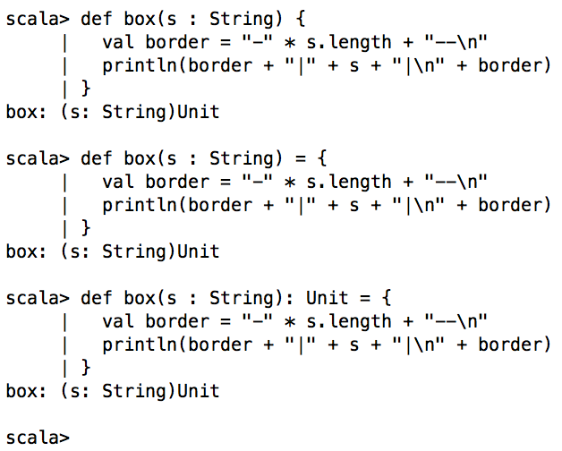
Procedures
Functions that return nothing i.e., Unit type

Slide 39
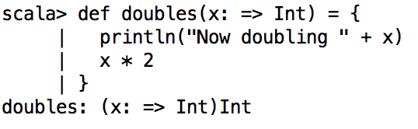
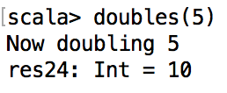
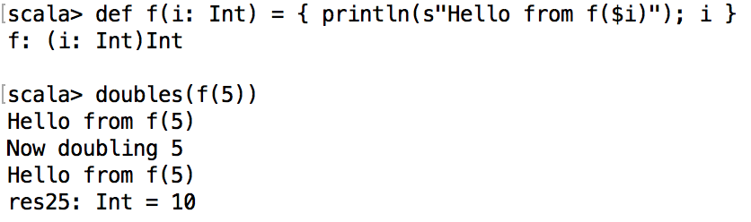
By-name parameters
Specifying a by-name parameter
It gets evaluated (into a value) each time it is referenced
If a value is passed, then there is no effect
If a function is passed, then it is invoked for every usage
<identifier>: => <type>
A parameter of type A acts like a val (its body is evaluated once, when bound) and one of type => A acts like a def (its body is evaluated whenever it is used).
Notes:
https://tpolecat.github.io/2014/06/26/call-by-name.html

Slide 40
Exercise
Write a function literal that takes two integers and returns the higher number (integer)
Skeleton code:
val max = (<you fill in>, <you fill in>) => <you fill in>
Notes:
https://tpolecat.github.io/2014/06/26/call-by-name.html

Slide 41
STRINGS

Slide 42
Strings
Scala does not have its own String class; it uses Java’s (java.lang.String)
So Java’s String class methods are available to you
Some popular String class methods are
Length: (# of chars in a string)
val palindrome = "A man, a plan, a canal, Panama"
val len = palindrome.length()
String concatenate
val str1 = "Hello "
val str2 = "World"
println("Concatenated strings " + str1 + str2)

Slide 43
Methods from java.lang.String
char charAt(int index): Returns the char value at the specified index.
int indexOf(int ch): Returns the index within this string of the first occurrence of the specified character.
String[] split(String regex): Splits this string around matches of the given regular expression
String substring(int beginIndex): Returns a new string that is a substring of this string.
more info on java.lang.String
https://docs.oracle.com/javase/6/docs/api/java/lang/String.html

Slide 44
String Interpolation
Scala notation for string interpolation is s prefix before 1st double quote in string (similar to Python)
val x = 20
println(s"The value of x is $x")
You can do calculations inside the variable (enclosed by curly braces)
println(s"The value of x is ${3*x}")

Slide 45
Regular Expressions
A regex is a string of characters (including punctuation) that represents a search pattern
Example is grep tool
Scala’s is based on java.util.regex.Pattern (note these may be a bit different from what you use in Python or grep)
val address = "123 Main Street Suite 101"
val numPattern = "[0-9]+".r

Slide 46
Then, we save the first match to
val match1 = numPattern.findFirstIn(address)
The general pattern is
val <regex value>(<identifier>) = <input string>
To get all values
val matches = numPattern.findAllIn(address)
matches.foreach(println)

Slide 47
Exercise
Using this string
val palindrome = "A man, a plan, 1221, a canal, Panama"
Try these
What is the 5th character?
What is the index of the letter “P”?
What happens when you do a string split on “plan”?
Create a substring “Panama”
Do a regular expression search for “1221”

Slide 48
TUPLES

Slide 49
Tuples
A tuple is a data structure where you can combine a fixed number of items together so that they can be passed around as a whole.
Different from Arrays or Lists, Tuples can hold objects with different types
but they are also immutable
Example
val t = (1, "hello", 123.45)
Tuples are of type Tuple1, Tuple2, Tuple3 etc
There currently is an upper limit of 22

Slide 50
Accessing Tuples
You may access Tuples using the following syntax:
val t = (4,3,2,1)
val sum = t._1 + t._2 + t._3 + t._4
println( "Sum of elements: " + sum )

Slide 51
Exercise
Write a function that calculates the length between a pair of points src and dest
Hint use the Tuple data structure!
Here is the method signature
def distance(src: (Int, Int), dest: (Int, Int)): Double = {
< you fill in >
}

Slide 52
Big EXERCISE
Build square root function using Newton’s Method

Slide 53
A little bit of theory
Want to calculate y = sqrt(x)
Equivalent to y² - x =0 or y – x/y = 0
We will try to approximate y using an estimated value, call it g_{i} (for guess at the ith iteration)
Idea is to have error of |g_{i} – x/g_{i}| get as small as possible
If we calculate a (new) value of g_{i+1} = the mean of (g_{i}, x/g_{i}), that should get us closer to the true value of y
i.e. g_{i+1}=(g_{i}+x/g_{i})/2

Slide 54
Build sqrt() function
Method to compute sqrt(x)
Start with an initial estimate y (say, y = 1)
Repeatedly improve the estimate by taking mean of (y, x/y)
Estimation | Quotient | Mean
1 | 2/1 = 2 | (1+2)/2 = 1.5
1.5 | 2/1.5 = 1.333 | (1.5+1.333)/2 = 1.4167
1.4167 | 2/1.4167 = 1.4118 | 1.4142
…

Slide 55
Code
def abs(x: Double) = <you fill in>
def sqrtIter(guess: Double, x: Double): Double =
if (isGoodEnough(guess, x)) guess
else sqrtIter(improve(guess, x), x)
def isGoodEnough(guess: Double, x: Double) = <you fill in>
def improve(guess: Double, x: Double) = <you fill in>
def sqrt(x: Double) = sqrtIter(1.0, x)
Try it on
1e6
1e-6

Slide 56

A Word on NULLs
Tony Hoare invented the NULL reference in the 1960s
Said it was a “billion dollar mistake” in computer science
Among other reasons, it’s hard to debug, to compare against etc
https://www.lucidchart.com/techblog/2015/08/31/the-worst-mistake-of-computer-science/
So, to avoid NULLs in your code, use the Option[T] keyword
Something that might not be there
You can think of it as a specialized kind of collection, that can contain either zero or one elements.
For example, instead of returning NULL, return Option[String]
def doSomething: Option[String] = { ... }

Slide 57
References
Discussion on NULLs
https://www.lucidchart.com/techblog/2015/08/31/the-worst-mistake-of-computer-science/
Scala best practices on dealing with NULLs
http://alvinalexander.com/scala/best-practice-eliminate-null-values-from-code-scala-idioms#don-t-return-null-from-methods
Java.lang.String documentation
https://docs.oracle.com/javase/6/docs/api/java/lang/String.html

